Slide 1
Simple Linear Regression

Slide 2

Regression Analysis
Regression analysis is used in stats to find trends in data.
For example, you might guess that there’s a connection between how much you eat and how much you weigh; regression analysis can help you quantify that.

Slide 3
Regression model
Relation between variables where changes in some variables may “explain” or possibly “cause” changes in other variables.
Explanatory variables are termed the independent variables and the variables to be explained are termed the dependent variables.
Regression model estimates the nature of the relationship between the independent and dependent variables.
Change in dependent variables that results from changes in independent variables, ie. size of the relationship.
Strength of the relationship.
Statistical significance of the relationship.

Slide 4
Examples
Dependent variable is retail price of gasoline in Regina – independent variable is the price of crude oil.
Dependent variable is employment income – independent variables might be hours of work, education, occupation, gender, age, region, years of experience, unionization status, etc.
Price of a product and quantity produced or sold:
Quantity sold affected by price. Dependent variable is quantity of product sold – independent variable is price.
Price affected by quantity offered for sale. Dependent variable is price – independent variable is quantity sold.

Slide 5
Bivariate and multivariate models
(Education) x y (Income)
(Education) x₁
(Gender) x₂
(Experience) x₃
(Age) x₄
Bivariate or simple regression model
Multivariate or multiple regression model
y (Income)
Model with simultaneous relationship
Price of wheat
Quantity of wheat produced

Slide 6
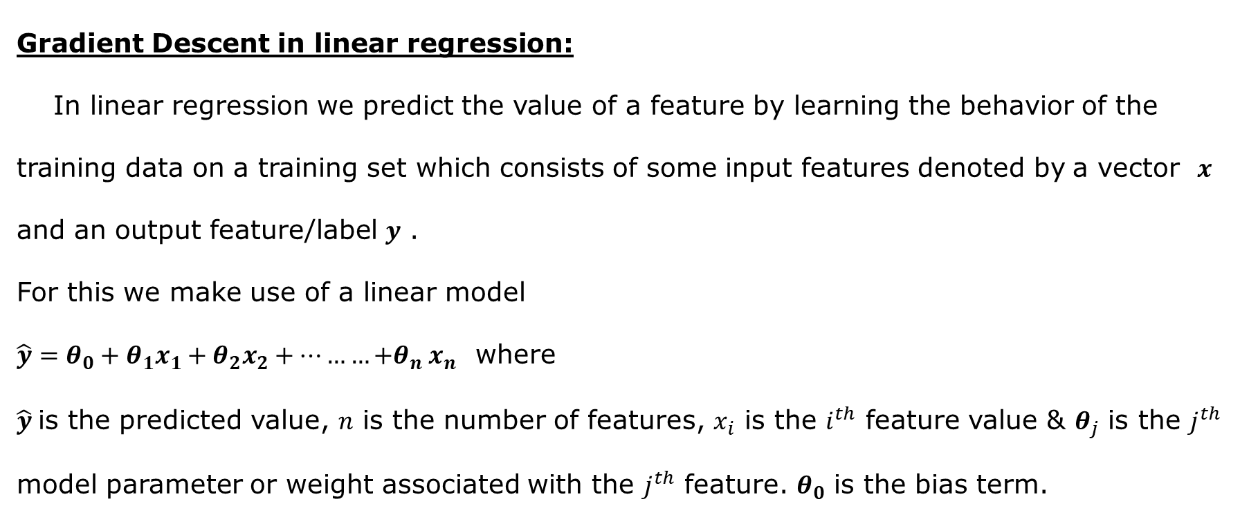
Regression Analysis…
Gradient Descent in linear regression:
In linear regression we predict the value of a feature by learning the behavior of the training data on a training set which consists of some input features denoted by a vector $x$ and an output feature/label $y$ .
For this we make use of a linear model
$\hat{y}=θ_{0}+θ_{1}x_{1}+θ_{2}x_{2}+………{+θ}_{n}x_{n}$ where
$\hat{y}$is the predicted value, $n$ is the number of features, $x_{i}$ is the $i^{th}$ feature value & $θ_{j}$ is the $j^{th}$ model parameter or weight associated with the $j^{th}$ feature. $θ_{0}$ is the bias term.

Slide 7
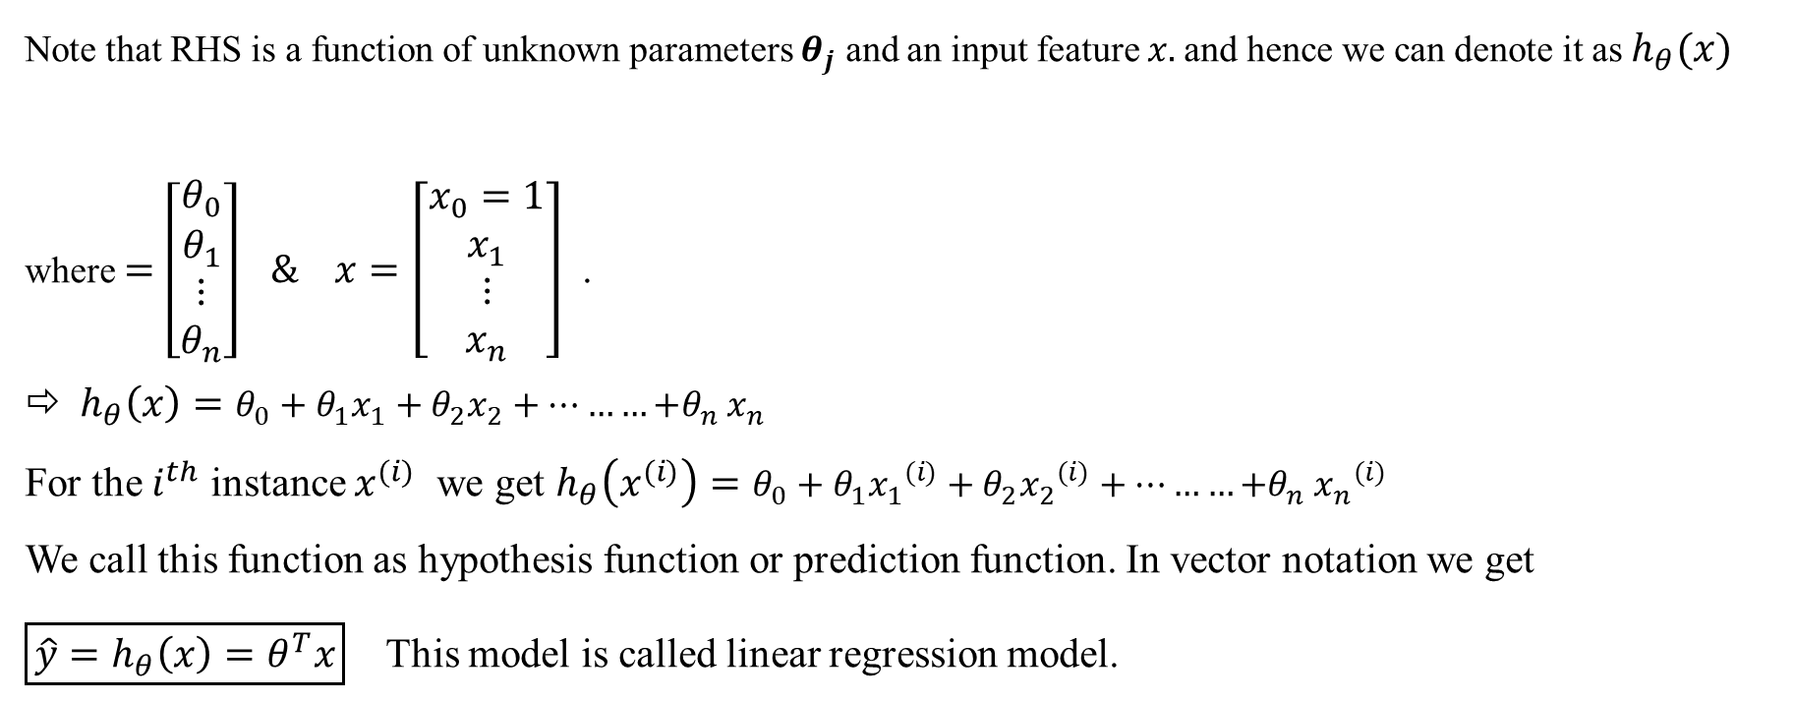
Regression Analysis…
Note that RHS is a function of unknown parameters $θ_{j}$ and an input feature $x.$and hence we can denote it as $h_{θ}(x)$ where $=\left[\begin{matrix}θ_{0} \\ θ_{1} \\ \begin{matrix}⋮ \\ θ_{n}\end{matrix}\end{matrix}\right] \& x=\left[\begin{matrix}x_{0}=1 \\ x_{1} \\ \begin{matrix}⋮ \\ x_{n}\end{matrix}\end{matrix}\right]$ .
$h_{θ}\left(x\right)=θ_{0}+θ_{1}x_{1}+θ_{2}x_{2}+………{+θ}_{n}x_{n}$
For the $i^{th}$ instance $x^{(i)}$ we get $h_{θ}\left(x^{(i)}\right)=θ_{0}+θ_{1}{x_{1}}^{(i)}+θ_{2}{x_{2}}^{(i)}+………{+θ}_{n}{x_{n}}^{(i)}$
We call this function as hypothesis function or prediction function. In vector notation we get
$\boxed{\hat{y}=h_{θ}\left(x\right)=θ^{T}x}$ This model is called linear regression model.

Slide 8
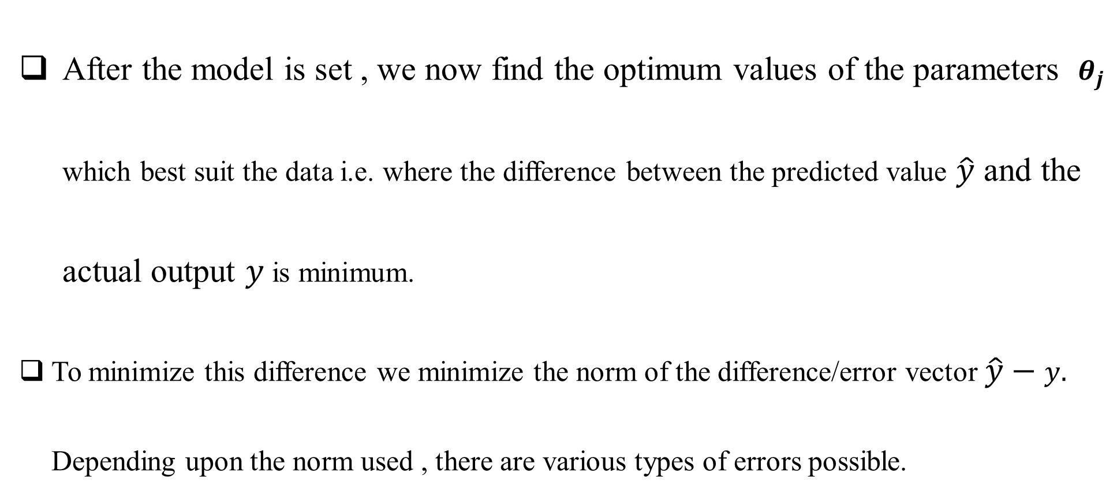
Regression Analysis…
After the model is set , we now find the optimum values of the parameters $θ_{j}$ which best suit the data i.e. where the difference between the predicted value $\hat{y}$ and the actual output $y$ is minimum.
To minimize this difference we minimize the norm of the difference/error vector $\hat{y}−y.$ Depending upon the norm used , there are various types of errors possible.

Slide 9
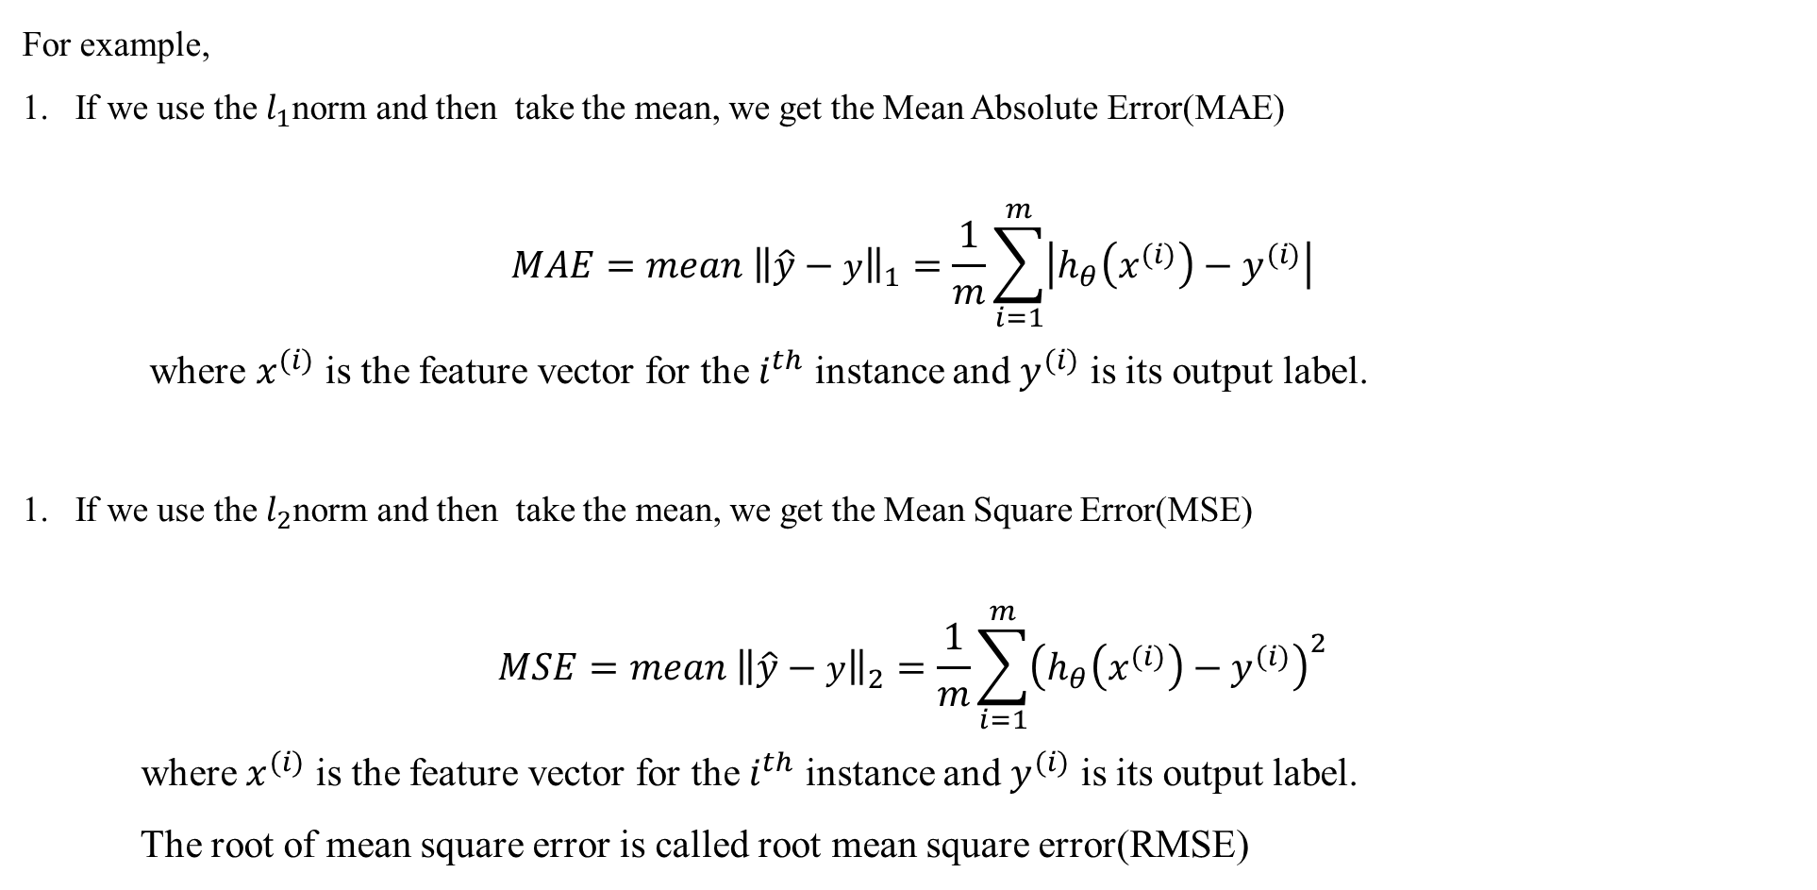
Regression Analysis…
For example,
If we use the $l_{1}$norm and then take the mean, we get the Mean Absolute Error(MAE)
$$MAE=mean {\left\|\hat{y}−y\right\|}_{1}=\frac{1}{m}\sum_{i=1}^{m}{\left|h_{θ}\left(x^{(i)}\right)−y^{(i)}\right|}$$
where $x^{(i)}$ is the feature vector for the $i^{th}$ instance and $y^{(i)}$ is its output label.
If we use the $l_{2}$norm and then take the mean, we get the Mean Square Error(MSE)
$$MSE=mean {\left\|\hat{y}−y\right\|}_{2}=\frac{1}{m}\sum_{i=1}^{m}{{\left(h_{θ}\left(x^{(i)}\right)−y^{(i)}\right)}^{2}}$$
where $x^{(i)}$ is the feature vector for the $i^{th}$ instance and $y^{(i)}$ is its output label.
The root of mean square error is called root mean square error(RMSE)

Slide 10
Regression Analysis…
After selecting the appropriate norm for optimization, we set the loss/cost function equal to the mean norm.
The mean square error is usually selected as the cost function as it is convex in nature and also a continuous function which facilitates the convergence of the algorithm used for optimization.

Slide 11
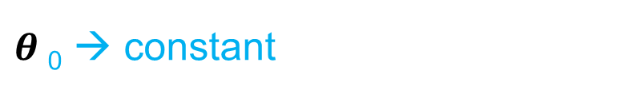

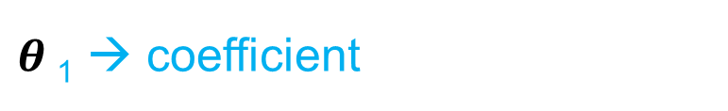
Simple Linear Regression
We predict scores on one variable from the scores of a second variable.
$$\hat{y}=θ_{0}+θ_{1}x$$
y → dependent variable
$θ$₀ → constant
$θ$₁ → coefficient
X → independent variable

Slide 12
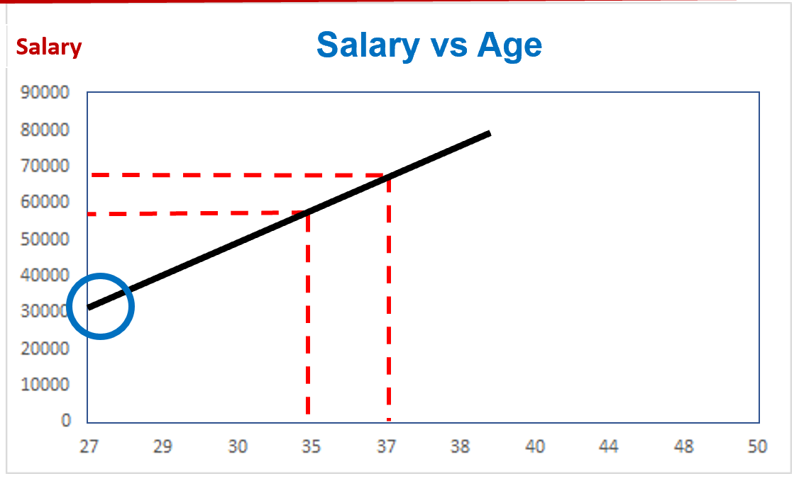

Simple Linear Regression…
$$\hat{y}=θ_{0}+θ_{1}x$$
Salary = $θ$₀ + $θ$₁ * age

Slide 13


Simple Linear Regression…How It Works ?
Salary
Actual value
+
y
+
+
+
+
+
+
$$\hat{y}$$
+
+
Predicted value
+
+
+
+
+
age
$sum(y−\hat{y})^{2}$→ minimum

Slide 14
Algorithm for Simple Linear Regression (SLR)
Import the libraries
Import the dataset
Splitting the data set into training set and testing set
Fitting Simple Linear Regression to the Training set
Predicting the Test set results
Visualising the Training set results
Visualising the Test set results

